Slide 1
BCOG 100
Language
Lecture 2: The Psychology of Language

Slide 2
Reading Check 11-1
Password: chomsky
Question: The article discusses language as being ”hierarchical”. What does that mean?

Slide 3
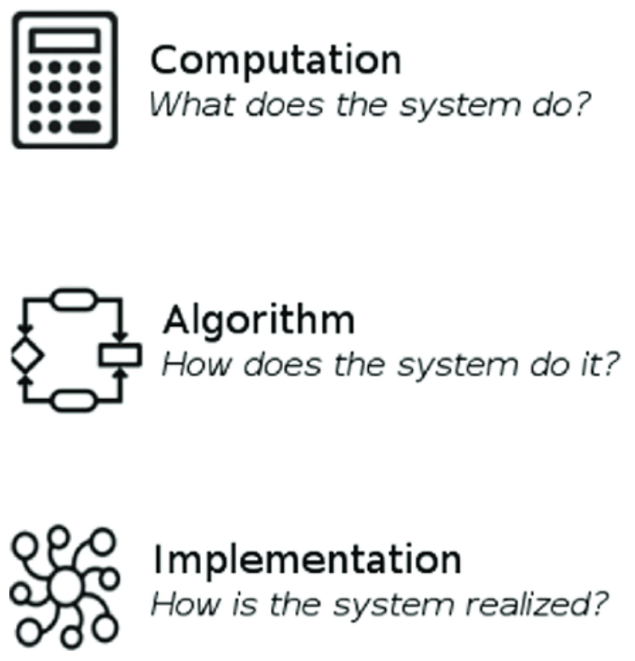
The Psychology of Language
Recap & Overview
Last Time:
Why language may have evolved, and what made it unique and beneficial
Today:
How minds represent, learn, and use language.
Notes:
Last time, we explored why language evolved—what problems it solved for early humans and how it transformed cooperation and culture.
We saw that language is both ancient and revolutionary: it built on primate communication but created new ways to share knowledge and imagination.
That lecture focused on the functional level—the adaptive reasons language exists.
Today we shift to a different question: how does language actually work in the mind?
What kind of system can produce, understand, and learn an open-ended set of sentences from limited experience?
We’ll look at theories of how language is represented, acquired, and processed, and at the debates that shaped modern cognitive science.
This brings us to the algorithmic level of Marr’s framework—the level of representations, rules, and learning mechanisms.
We’ll start historically, with early behaviorist ideas about learning, then see how Chomsky’s critique transformed psychology.
From there, we’ll trace how newer approaches—connectionist, statistical, and social—have reimagined what it means for a mind to “do” language.
By the end of this lecture, we’ll see that the central question is still unresolved:
Is language a system of innate symbolic rules, or a product of experience and learning?
The rest of the course will build on this puzzle as we turn next to the brain systems that implement it.

Slide 4
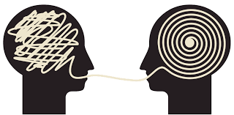
The Psychology of Language
How Can a Mind Do Language?
Language seems infinite, but the brain is finite
We produce and understand sentences we’ve never heard
How can a physical mind generate such creativity?
Notes:
The central mystery of language is how a limited biological system produces unlimited expression.
Every fluent speaker can generate and comprehend sentences that no one has ever said before.
This means language isn’t just a list of learned phrases
—it’s a generative system, capable of creating new meanings on demand.
At first glance, that seems impossible for a brain made of neurons.
How could a network of cells, bound by time and memory constraints,
represent something as flexible and open-ended as human language?
What kinds of internal structures or learning processes could explain this ability?
This is the question that drove much of twentieth-century cognitive science.
Some researchers proposed that language relies on innate symbolic rules
—mental grammar guiding how words combine.
Others argued that such structure can emerge from learning
—that with enough experience, general-purpose mechanisms
can discover patterns on their own.
Still others emphasize interaction and motivation
—that language is rooted in social intention, not just computation.
Today, we’ll explore how these competing answers
—rules, learning, and social cognition—each explain part of the mystery.
Understanding how a mind can do language means understanding how structure, experience, and communication all come together to make thought shareable.

Slide 5
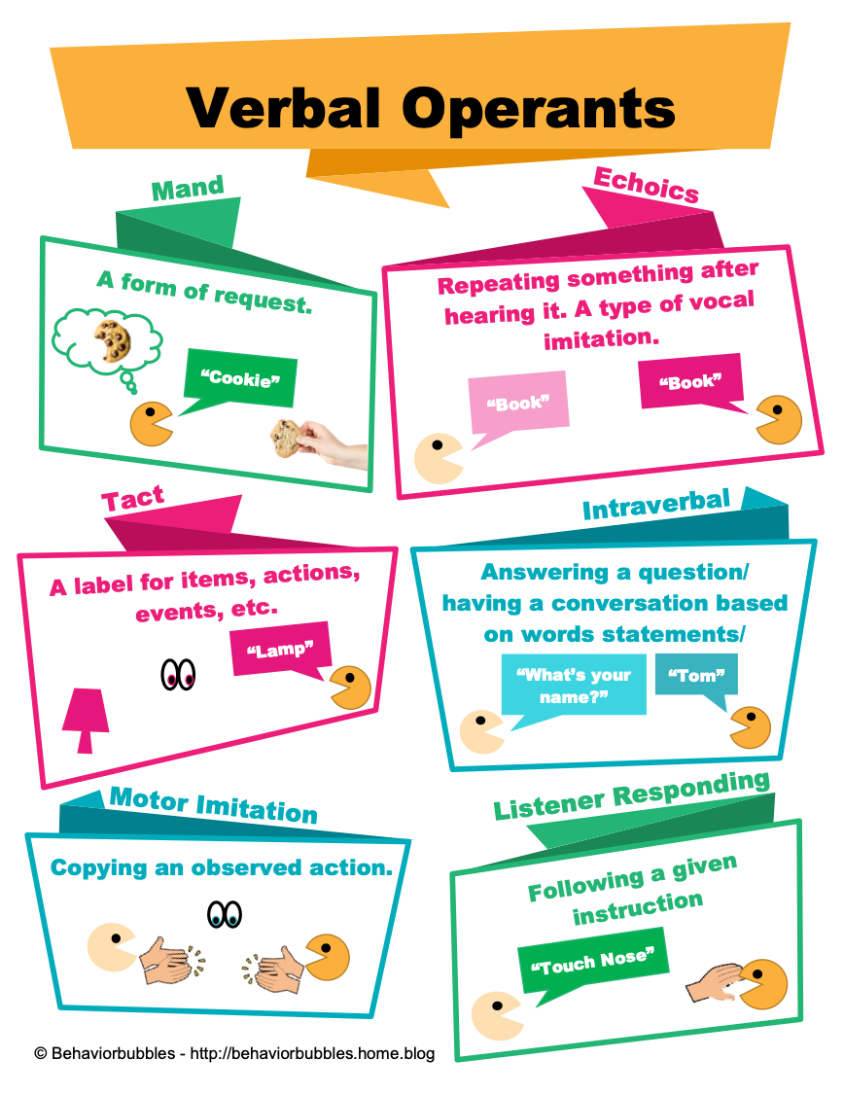
The Psychology of Language
Skinner’s Verbal Behavior
Language as learned behavior through reinforcement
Speech shaped by environment, not internal rules
A powerful idea that met powerful criticism
Notes:
In the mid-20th century, psychology was dominated by behaviorism
—the view that science should focus only on observable behavior, not invisible mental states.
B.F. Skinner extended this framework to language in his 1957 book Verbal Behavior.
He argued that speaking is simply another form of behavior shaped by reinforcement and conditioning,
just like a rat pressing a lever for food.
In this model, a child learns to say “milk” because saying the word is followed by a reward—receiving milk.
Over time, repeated pairings strengthen the association between the word and its outcome.
Skinner also proposed that speech develops through shaping—gradual reinforcement of successive approximations.
For example, a parent might praise “mi” or “muh” at first, and later only reinforce the complete word “milk.”
As a result, fluent language emerges from a long chain of small learned steps, each reinforced by success.
He also invoked generalization: once a word is learned, it can be used in new but similar situations
—saying “milk” for a different cup, or “dog” for a new animal that resembles one already known.
In this view, there is no need for internal “rules” or abstract grammar.
All verbal behavior can, in principle, be explained by environmental history
—stimuli, responses, and reinforcement.
The mind is a black box, and language learning is a special case of general learning principles
shared across species.
Behaviorism was appealing because it offered a mechanistic, testable account of learning.
It avoided speculation about hidden mental processes, emphasizing data and control.
But language posed a special challenge.
Children often produce sentences they’ve never heard and understand meanings
that go far beyond direct reinforcement.
That creative flexibility raised doubts that conditioning alone could explain how language works.
Within a few years, this behaviorist view faced a devastating critique that would reshape the entire field.
The challenge came from a young linguist named Noam Chomsky,
who argued that language could not possibly be learned this way
—and that its explanation required reintroducing
the very thing behaviorism had banished: the mind.

Slide 6
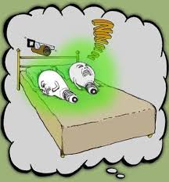
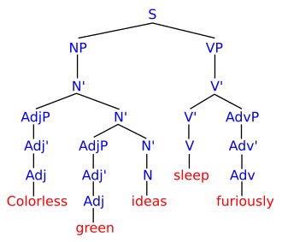
The Psychology of Language
Ideas colorless sleep green furiously
Colorless green ideas sleep furiously
Chomsky’s Critique of Behaviorism
According to Chomsky, language is creative, not just imitative
Children say things they’ve never heard
Reinforcement can’t explain infinite productivity
Notes:
In 1959, Noam Chomsky published a review of Skinner’s Verbal Behavior that changed the course of psychology.
He argued that language could not be explained by reinforcement and imitation alone.
Instead, it revealed the existence of an internal mental structure—a generative system that allows humans to create and understand an infinite range of expressions.
Chomsky pointed out that children don’t just repeat what they hear.
They produce novel, grammatically correct sentences they’ve never been exposed to.
A child might say, “I goed to the park,” showing understanding of a rule (“add -ed”) rather than rote memorization.
Even more striking, parents rarely reward or punish grammatical correctness, focusing instead on meaning or behavior—so reinforcement couldn’t explain learning syntax.
He also noted that much of the input children receive is fragmentary or ungrammatical, full of false starts and incomplete sentences.
Yet children somehow infer complex grammatical systems from this noisy, imperfect data.
This was the basis of his famous claim about the poverty of the stimulus: that linguistic input alone is insufficient to explain what children know.
Therefore, something about language must be innate—a built-in structure that constrains what forms are possible.
Chomsky’s critique dismantled the behaviorist approach to language and helped launch the cognitive revolution.
It reintroduced the mind as a legitimate subject of scientific study, framing it as an information-processing system rather than a black box.
Psychology shifted from studying only behavior to studying the mental representations and rules that underlie it.
This was more than just a dispute about language—it was a new vision of the mind itself.
The brain, in Chomsky’s model, wasn’t just reacting to the world.
It was actively constructing structure—a computational engine that generates thought and expression according to deep, universal principles.

Slide 7
The Psychology of Language
Universal Grammar and the Birth of Cognitive Science
Chomsky argues humans are born with an innate language faculty
Universal Grammar constrains what languages can be
Language became the model system for studying the mind
Sub-Idea | Brief Description
Universal Grammar (UG) | A set of innate linguistic principles shared by all humans that constrain what forms a possible language can take.
Parameters and Triggers | Children “set” parameters (e.g., word order, subject omission) based on limited exposure to their native language.
Poverty of the Stimulus | The input children receive is too limited and error-filled to explain their rapid mastery, implying innate knowledge.
Deep vs. Surface Structure | Sentences have an abstract underlying structure (deep) that can be transformed into various surface word orders.
Transformational Rules | Grammar includes operations (e.g., move the auxiliary for a question) that link related sentence forms.
Competence vs. Performance | UG describes the idealized mental grammar (competence) distinct from everyday errors in speech (performance).
Language Faculty / LAD | A specialized, evolutionarily evolved system in the brain (Language Acquisition Device) for building grammar.
Notes:
In Chomsky’s framework, language learning is possible only because humans are born with an innate grammatical blueprint—a biological endowment he called Universal Grammar (UG).
UG defines the abstract principles that all human languages share: for example, that sentences have hierarchical structure, that words belong to categories like noun and verb, and that grammatical rules operate over these abstract relationships rather than over linear word order alone.
Each child’s task, in this view, is not to invent language from scratch, but to set the parameters of this universal system based on the examples they hear.
Exposure to a particular language triggers the selection of specific settings—word order, morphology, case marking—but the underlying architecture is already in place.
This explains why children learn so quickly and why every human culture, regardless of environment, develops language on a similar timetable.
Chomsky’s proposal transformed linguistics and launched a new way of thinking about the mind.
If the brain contains specialized computational systems for language, then other mental capacities might be understood the same way—as structured, rule-governed systems that process symbolic information.
Language became the model system for cognitive science, inspiring parallel research in memory, vision, and reasoning.
The result was a new image of the human mind: not a blank slate shaped entirely by experience, but a structured, computational system shaped by evolution.
This “mental grammar” hypothesis would dominate cognitive psychology for decades.
But it also provoked an equally powerful response from those who saw language not as innate software, but as an emergent product of learning, usage, and social interaction—a debate that continues today.

Slide 8
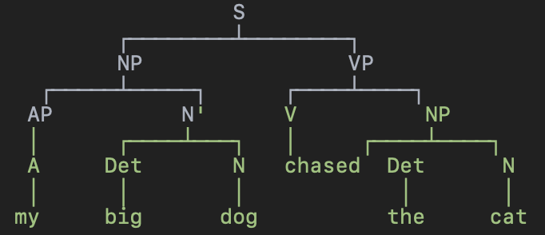
The Psychology of Language
The Mind as a Rule System
Language as computation over symbols
Sentences generated by rules, not memorized strings
The mind as a grammar engine for thought
Syntactic Structure
Grammar
S → NP VP
NP → (AP) Det N
VP → V (NP) (PP)
PP → P NP
AP → A
Det → [the, a, my, your]
N → [dog, cat, friend, book]
V → [chased, read, saw, likes]
P → [with, to, near]
A → [big, small, happy, tired]
Notes:
Building on Chomsky’s ideas, early cognitive scientists treated the mind
as a rule-based system that manipulates discrete symbols.
Just as a computer combines binary elements according to formal operations,
the human mind combines words and phrases according to grammatical rules.
This framework became known as the computational theory of mind
—the idea that thinking and language both rely on symbolic representations
and rule-governed transformations.
Language was the clearest example of this principle in action.
Speakers can generate an infinite number of new sentences because grammar operates recursively:
a noun phrase and verb phrase can combine to form a sentence, which can itself become part of a larger one.
This hierarchical structure, not mere word order,
explains why “The dog chased the cat” differs from “The cat chased the dog.”
The mind’s grammar engine ensures that meaning follows from structure, not memorized sequences.
Early cognitive models tried to formalize these operations explicitly.
They described how a sentence might be generated step by step,
or how a listener could parse a sequence by matching it against stored rules.
These “symbolic” systems became the foundation for both linguistic theory
and early artificial intelligence, which sought to replicate human reasoning with similar rule sets.
This approach explained key aspects of linguistic productivity and structure—but it also raised deep questions.
If the mind works like a grammar processor, how do those rules get learned or represented in neurons?
And if rules are abstract and universal, why do languages differ so widely?
These questions would soon expose the limits of the symbolic view
—and open the door to alternative, learning-based accounts.

Slide 9
The Psychology of Language
Grammar in the Mind
Sentences unfold in structure, not in a straight line
The mind tracks categories, dependencies, and expectations
Psycholinguistics reveals grammar as a mental process
Garden-Path Sentences
The old man the boats.
The horse raced past the barn fell.
While Anna dressed the baby played in the crib.
The man whistling tunes pianos.
The spy saw the man with binoculars.
Notes:
If language depends on internal rules,
then those rules must shape how people process sentences in real time.
Psycholinguists in the 1960s and 1970s began testing this idea
by studying how listeners and readers build structure as they go.
Their experiments showed that people don’t wait until the end of a sentence to interpret it
—they continuously construct syntactic trees in the mind.
For example, when hearing “The old man the boats,”
most listeners initially misinterpret “man” as a noun rather than a verb.
This garden-path effect shows that comprehension follows grammatical expectations:
the mind momentarily commits to one parse, then backtracks when the sentence violates it.
Such findings supported the view that the brain has an active parser
guided by grammatical rules and category constraints.
Other evidence came from reaction times, eye-tracking, and speech errors.
People are faster to understand sentences that follow expected word orders,
and they often make slips that preserve grammatical structure:
“I roasted a cook” instead of “I cooked a roast”.
These patterns reveal an underlying system that operates on linguistic units and relationships,
not just sequences of sounds or words.
The picture that emerged was of a mental grammar
—a structured system that organizes how language is produced and understood.
It works automatically and unconsciously, using syntactic knowledge
to anticipate meaning and resolve ambiguity.
To many researchers, this was strong support for the idea that language competence
and language use or performance share the same rule-based architecture.
Still, even as psycholinguistic evidence supported the idea
that people organize language structurally,
what that means remains deeply debated.
Some researchers see these patterns as proof of an internal, rule-based grammar engine.
Others argue that they reflect emergent regularities
—habits and predictions built from experience, not explicit rules.
And some propose that “grammar” may be more of a descriptive model
than a literal mechanism in the brain.
The evidence shows that language processing is structured,
but not necessarily how that structure is represented or implemented.

Slide 10
The Psychology of Language
Limits and Critiques of the Symbolic Model
Rules explain structure, but not learning
Real language is messy, graded, and contextual
The symbolic mind may be too rigid to capture it
the … uh.. big… no I mean small dog chased the cat
Notes:
By the late 1970s, cracks had begun to show in the symbolic approach.
Formal grammar models could describe sentence structure,
but they didn’t explain how people learned or processed those structures.
Children’s speech revealed gradual, piecemeal development
—patterns like “goed” and “mouses” that suggested rule-like generalization,
but also flexible adaptation.
Symbolic models predicted discrete shifts, yet real learners showed overlap, variability, and partial knowledge.
Everyday language further strained the model.
People rarely speak in perfect sentences.
They pause, restart, and revise: “The boy—uh—the boys were running.”
We use fragments like “Dinner?” or “Got it,” and still understand perfectly.
Symbolic grammars treated such utterances as ill-formed, but speakers and listeners handle them effortlessly.
Language in the wild is full of graded acceptability, not all-or-nothing rules.
Experimental evidence also pointed toward flexibility.
In sentence-processing studies, people’s reading times and eye movements reflected expectation
—they slowed down when a word violated what was likely, even if it was grammatical.
For example, “The cat will bake…” causes a brief disruption, because “bake” is unexpected after “cat.”
This predictive behavior suggests that comprehension depends on experience-based probabilities, not just symbolic syntax.
Cross-linguistic research exposed similar cracks.
Languages differ dramatically in how they mark tense, gender, or word order,
yet children master them all using similar learning mechanisms.
If grammar were a rigid, innate rule system, such diversity would be difficult to account for.
Instead, evidence hinted that language structure adapts to usage pressures—efficiency, frequency, and communicative need.
Even at the theoretical level, many linguists found themselves
patching the symbolic framework with exceptions and sub-rules to account for irregularities.
For instance, English question formation—“The boy who is tall is running”
→ “Is the boy who is tall running?”—works differently from similar constructions in other languages.
Rules proliferated faster than they could be tested.
The symbolic model succeeded in describing the architecture of language, but struggled to explain its learning, variation, and use.
Researchers began to ask whether linguistic structure might emerge from experience—that perhaps the mind infers patterns statistically from input, rather than following built-in algorithms.
This question led directly to the rise of connectionism and the return of learning-based theories in the 1980s.

Slide 11
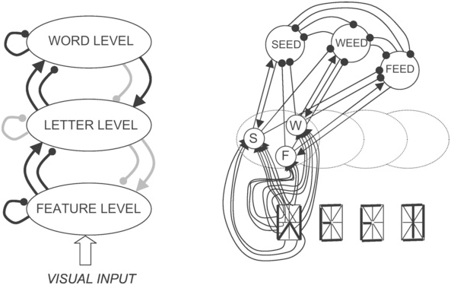
The Psychology of Language
Connectionism and the Return of Learning
Structure can emerge from experience
Networks learn patterns, not explicit rules
Generativity may come from prediction, not innateness
Notes:
In the 1980s, a new framework challenged the dominance of symbolic models: connectionism.
Inspired by neuroscience, connectionism treated the mind not as a rule-based computer,
but as a network of simple processing units that learn by adjusting their connections.
Instead of storing explicit grammatical rules,
these networks discovered patterns and regularities through exposure
—capturing knowledge in the strengths of connections rather than in symbolic code.
A landmark example was the Rumelhart and McClelland (1986) model of English past tense.
Trained on verbs like walk → walked and run → ran,
it gradually learned to generalize patterns and produce novel forms.
At first, the network overgeneralized—producing goed or comed, just like children do
—then refined its behavior as it encountered more examples.
This learning curve, once thought uniquely human, emerged from experience alone,
with no innate grammar or symbolic rules.
Connectionist models could also simulate other aspects of cognition:
speech perception, word recognition, and sentence comprehension.
They showed that distributed representations—patterns of activation across many units
—could encode relationships, categories, and sequences.
Language-like structure arose naturally when networks learned to predict upcoming sounds or words,
much as human listeners anticipate what comes next in a sentence.
This was a major conceptual shift.
Earlier theorists like Chomsky had argued that language’s generativity
—its ability to produce infinite sentences—proved that rules must be innate.
But connectionism showed that generativity can emerge from learning itself.
Predictive networks trained on structured input
could create novel combinations without ever being told explicit rules.
In that sense, they rediscovered what evolution had achieved long before in mammals and primates:
systems that model and generate behavior through prediction and feedback.
Of course, these early models were simplified and often limited in scope.
They required massive training data and still struggled with long-distance dependencies or complex syntax.
But their success opened the door to a new view of language:
not as a special, innate module, but as a natural product of pattern learning in a structured world.
Connectionism helped repopularize learning in the study of language
—and reminded cognitive science that generative structure need not come from prewired rules,
but can emerge from experience, interaction, and prediction.

Slide 12
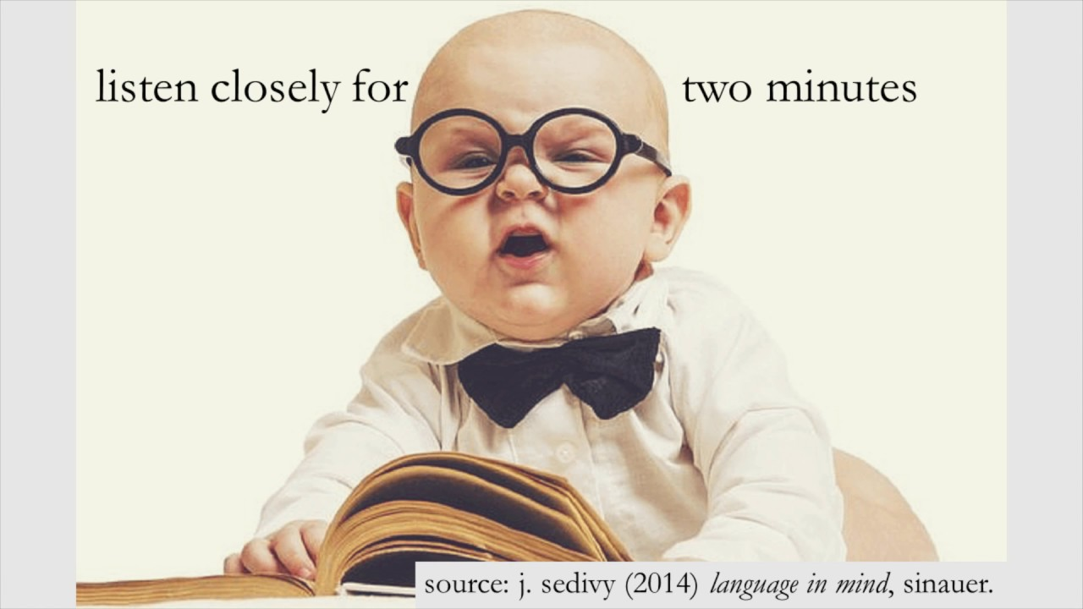
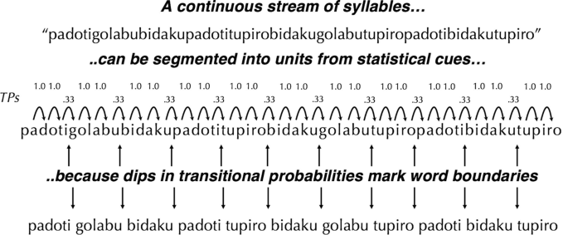
The Psychology of Language
Statistical Learning and the Structure of the Input
Learners track patterns in what they hear
Structure can be discovered in the input itself
The world may teach more than Chomsky thought
Notes:
In the 1990s, studies of statistical learning revealed that humans
—especially infants—are remarkably sensitive to patterns in sound.
When exposed to a stream of syllables with no pauses,
babies can identify word boundaries simply by tracking which syllables tend to occur together.
This was the core finding of Saffran, Aslin, and Newport (1996):
eight-month-olds extracted structure from raw input after only a few minutes of exposure.
The brain, it seemed, was tuned to detect probabilities, not just memorize words.
Such experiments challenged the claim that linguistic input is too impoverished to guide learning.
Natural language is full of statistical regularities: frequent patterns of sound, word order, and meaning.
Infants, and even adults, exploit these cues automatically.
Instead of needing an innate grammar, learners might infer structure by modeling how elements co-occur over time.
Follow-up studies extended this finding across domains
—music, visual sequences, and tone patterns
—suggesting that statistical learning is a domain-general skill.
It may underlie everything from recognizing phonemes to predicting syntax and meaning.
Rather than being preprogrammed for language, the brain may simply be equipped to find structure in a structured world.
The input itself could carry much of the scaffolding once attributed to innate rules.
This doesn’t mean grammar is an illusion
—only that it might emerge from sensitivity to distributional information.
Human learners appear to build internal structure by tracking what predicts what,
forming expectations that grow richer with experience.
Language, on this view, is less a special organ than a natural outcome of a powerful pattern-detection system.

Slide 13

The Psychology of Language
The Social Prerequisites for Language
Humans are driven to share minds, not just sounds
Language depends on motivation to communicate
Sociality may be the key difference, not intelligence
Notes:
Even if other species can learn signals or patterns, they rarely use them to share information intentionally.
Humans, in contrast, seem wired for communication—motivated to connect, teach, and exchange ideas.
Language may rely less on unique cognitive hardware and more on an unusual degree of social motivation.
We don’t just learn to talk; we want to talk.
Developmental studies highlight this distinction.
Infants as young as one year point, gesture, and look back and forth between people and objects to share attention.
These acts, called joint attention, predict vocabulary growth far better than raw exposure alone.
They show that learning words depends on understanding that others have minds worth informing.
Comparative research reinforces the point.
Apes trained in human environments can learn symbols, but they rarely use them to comment, teach, or ask.
They communicate to request or protest, not to share what they know.
Humans, by contrast, seem compelled to inform for its own sake, finding social reward in mutual understanding.
This difference suggests that language rests on a foundation of shared intentionality—the ability and desire to align mental states with others.
It’s not just what humans can represent, but what they care to represent together.
Our brains may not be the only ones capable of structured signals, but they are the ones most motivated to fill them with meaning.

Slide 14
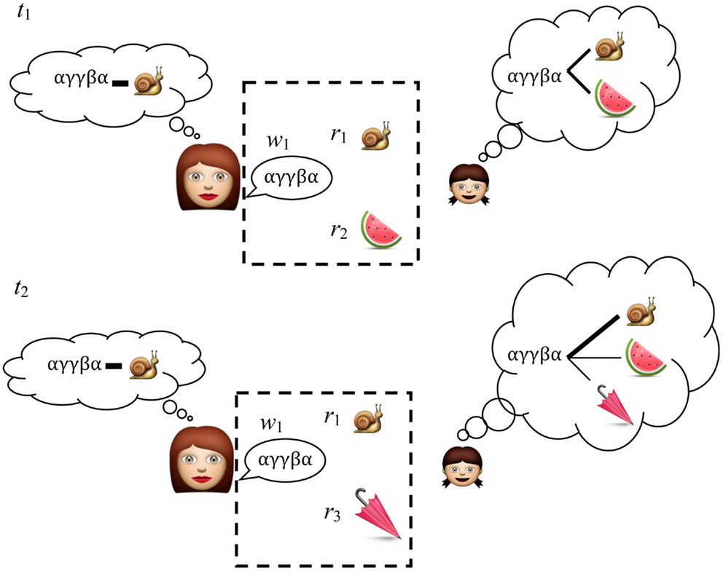
The Psychology of Language
Usage-Based and Constructivist Approaches
Language grows out of social use
Learning, attention, and intention work together
Grammar emerges where communication succeeds
Notes:
Usage-based and constructivist approaches see language as a joint achievement of learning and communication.
Children don’t begin with abstract rules; they begin with social exchanges.
They learn words and phrases while trying to make themselves understood—first by imitating, then by innovating.
Grammar emerges gradually from these repeated acts of meaning-making.
Researchers such as Tomasello and Bates argue that linguistic structure reflects our shared social motives as much as our learning mechanisms.
Children pay close attention to what others look at, intend, and react to.
They infer meaning not just from patterns of sound, but from patterns of interaction—what words accomplish in context.
Statistical sensitivity helps them track regularities, but the drive to connect makes those patterns matter.
Evidence supports this synthesis.
Children who engage more in joint attention and conversational turn-taking show faster grammatical growth.
They often use flexible, semi-formulaic constructions—“I want X,” “Let’s go Y”—that adapt to new communicative needs.
These early templates become the foundation for more complex grammatical systems.
From this perspective, language is best understood as social cognition in motion.
The mind discovers structure by participating in communication, not by decoding it in isolation.
Statistical learning provides the mechanism; social motivation provides the purpose.
Together, they make grammar an emergent property of shared intention.

Slide 15

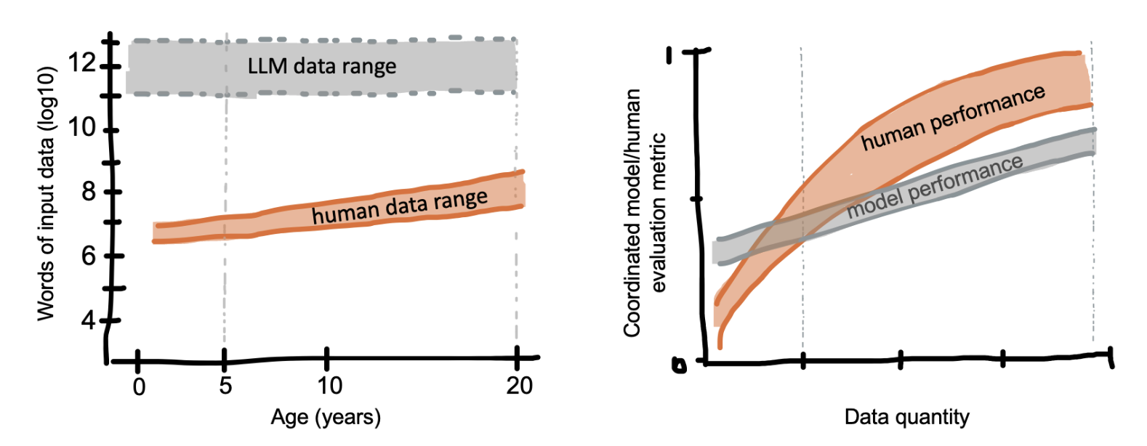
The Psychology of Language
Modern Machine Learning and Language
Computers now learn language from data, not rules
Patterns emerge from prediction, not programming
Machines echo human debates about learning and structure
Notes:
Recent advances in machine learning have revived many of the same questions raised in cognitive science.
Modern language models are not programmed with grammar; they learn by predicting what word comes next in massive text corpora.
Through exposure alone, these systems acquire syntax, semantics, and even pragmatic cues—without explicit teaching.
Their success demonstrates the power of learning from data-rich environments.
At first glance, this looks like a triumph for empiricism and connectionism.
Networks trained on trillions of words develop internal representations of meaning and structure that resemble those found in human brains.
They capture grammatical regularities, word categories, and thematic roles simply by tracking which patterns predict others.
Structure seems to emerge naturally from prediction, just as statistical learning theories propose for humans.
Yet these systems also expose the limits of pure learning.
They lack genuine understanding, grounded experience, and social motivation.
A model can generate fluent sentences, but it does not know what they refer to or care why they’re said.
This gap reminds us that human language is embedded in goals, embodiment, and shared meaning—contexts machines do not yet possess.
For cognitive scientists, modern AI is a mirror.
It shows that pattern learning can produce astonishing structure, but also that language is more than prediction.
Our communicative minds combine statistical sensitivity with motivation, memory, and theory of mind.
In studying both humans and machines, we uncover not just how language is learned, but what it means to use it.

Slide 16
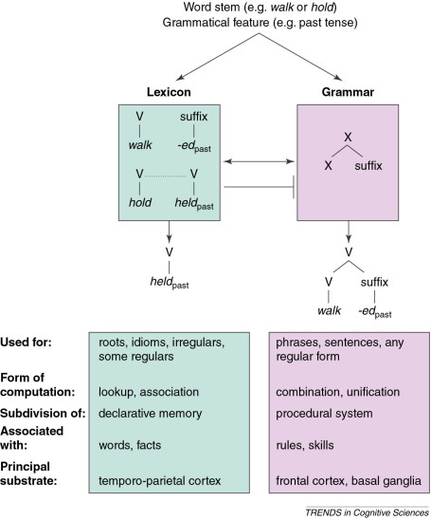
The Psychology of Language
Debate Example 1: Morphology Acquisition
Do we apply rules or learn patterns?
Past tense and plurals reveal how we generalize
Language learning turns memory into structure
Notes:
Now that we’ve traced the major theories—from Skinner’s behaviorism and Chomsky’s grammar to modern learning and social accounts—let’s see how those ideas hold up against the evidence.
In the next set of slides, we’ll look at classic experiments and case studies that have tested these competing views head-to-head.
Each one examines a different piece of the language system—how we learn words, build sentences, or interpret meaning—and asks the same underlying question:
Are we born with linguistic rules, or do those rules emerge from learning, interaction, and prediction?
We first saw the English past tense when connectionist models learned forms like walk → walked and run → ran.
That work showed that children, and networks, overgeneralize before recovering—producing goed or comed and later correcting them.
It captured the gradual, graded character of learning, suggesting that regularity can emerge from exposure rather than from explicit rules.
But many researchers argued that this story applies more broadly to morphology, including plurals and other inflections.
In the “Wug test”, Jean Berko Gleason showed that children can add -s to a novel word (“This is a wug—now there are two ___”).
They apply the rule productively, not just to memorized forms, suggesting some kind of abstract structure.
Steven Pinker and Michael Ullman proposed a dual-route model: a symbolic rule system for regular forms (cats, walked), paired with associative memory for irregulars (mice, went).
This model preserved grammar as a distinct cognitive component while acknowledging learning and storage effects.
Connectionist and statistical models offered a different explanation.
They argued that regular and irregular forms lie on a continuum of frequency and similarity.
Common patterns like -ed or -s are simply the most entrenched clusters in experience, and irregulars persist when they’re frequent enough to resist analogical pressure.
From this view, the mind doesn’t switch between rules and memory—it generalizes over everything it has heard.
Together, these findings highlight how language turns experience into abstraction.
Morphological patterns may appear rule-like, but they can emerge naturally from distributed learning, prediction, and analogy.
Whether we describe that process as “rule application” or “pattern activation” may depend more on the level of description than on a real division in the brain.
Either way, the English morphology debate remains a touchstone for understanding how structure arises from learning.

Slide 17
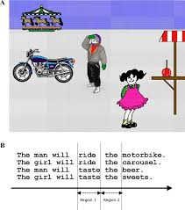
The Psychology of Language
Debate Example 2: Understanding Sentences: Rules or Predictions?
Do we follow grammar or guess ahead?
Meaning unfolds through expectation and context
Parsing may be prediction in disguise
Notes:
Traditional models viewed sentence comprehension as a rule-driven process: listeners build syntactic structures step by step, guided by grammar alone.
Ambiguity and reanalysis—like in “While Mary was mending the sock fell off her lap”
—were seen as proof that the parser follows syntax first, then assigns meaning later.
In this view, language understanding is modular: syntax leads, semantics follows.
But evidence from eye-tracking and reading-time studies paints a different picture.
People slow down not only when syntax is violated but when a word is simply unexpected.
“The cat will bake…” causes disruption despite being grammatical, because “bake” is improbable.
Such surprisal effects reveal that the brain continually predicts what comes next, weighting possibilities by likelihood rather than waiting for full structure.
Context and meaning also shape comprehension almost instantly.
Subtle cues—like plausibility or prior discourse—can prevent garden-path errors before they occur.
For example, “The mechanic told the customer that the car would…” primes start, not bake or sing.
Semantic and pragmatic expectations guide understanding as strongly as syntactic rules do.
Together, these findings suggest that sentence comprehension is a constraint-satisfaction process.
Grammar provides structure, but meaning and probability drive timing and interpretation.
The mind doesn’t just apply rules—it predicts, using every available cue to stay one step ahead.
Language, like vision or movement, is an active process of anticipating the world before it’s fully revealed.

Slide 18
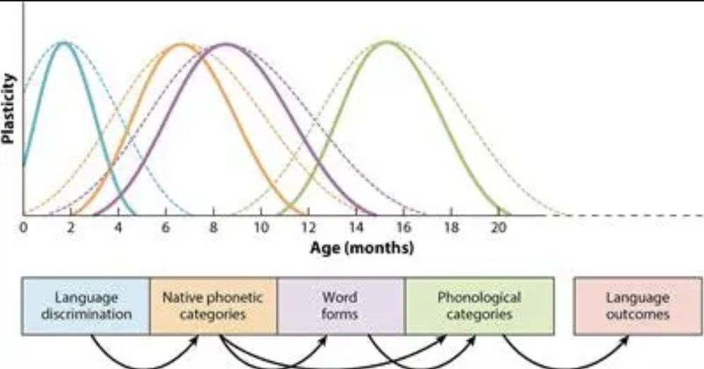
The Psychology of Language
Debate Example 3: Critical Periods in Language Acquisition?
Is there a window for mastering language?
Does biology close the door, or can experience reopen it?
Timing tests the balance of nature and nurture
Notes:
As psycholinguistics matured, attention shifted from how people learn grammar to how they use it in real time.
Traditional symbolic models assumed that comprehension involves building syntactic structures according to formal rules.
But newer research began to show that people also rely on statistical expectations—subtle predictions about what word or structure is likely to come next.
Understanding language, it seemed, might be as much about forecasting as about following rules.
Evidence came from eye-tracking and reaction-time studies.
When readers encounter an unlikely word, they slow down or regress, even if the sentence is perfectly grammatical.
For example, people pause longer on “The cat will bake…” than on “The boy will bake…,” though both obey syntax.
This “surprisal effect” suggests that the mind constantly weighs how probable each continuation is, not just whether it is permitted by grammar.
Computational models confirmed this pattern.
Statistical parsers that estimate word-by-word probabilities could predict human reading times with remarkable accuracy.
Such models treated comprehension as incremental inference—combining syntax, meaning, and experience to update expectations with each new word.
Parsing, from this view, is not rule-following but probabilistic hypothesis testing.
Still, supporters of symbolic grammar note that probability alone cannot explain all aspects of sentence understanding.
People can parse sentences they’ve never heard before, and they recover from ambiguity using deep structural cues, not just frequency.
Most researchers now agree that comprehension blends both forces: an underlying grammar constrains possibilities, while experience guides expectations.
Language understanding, like language learning, may depend on the dynamic interplay between structure and prediction.

Slide 19
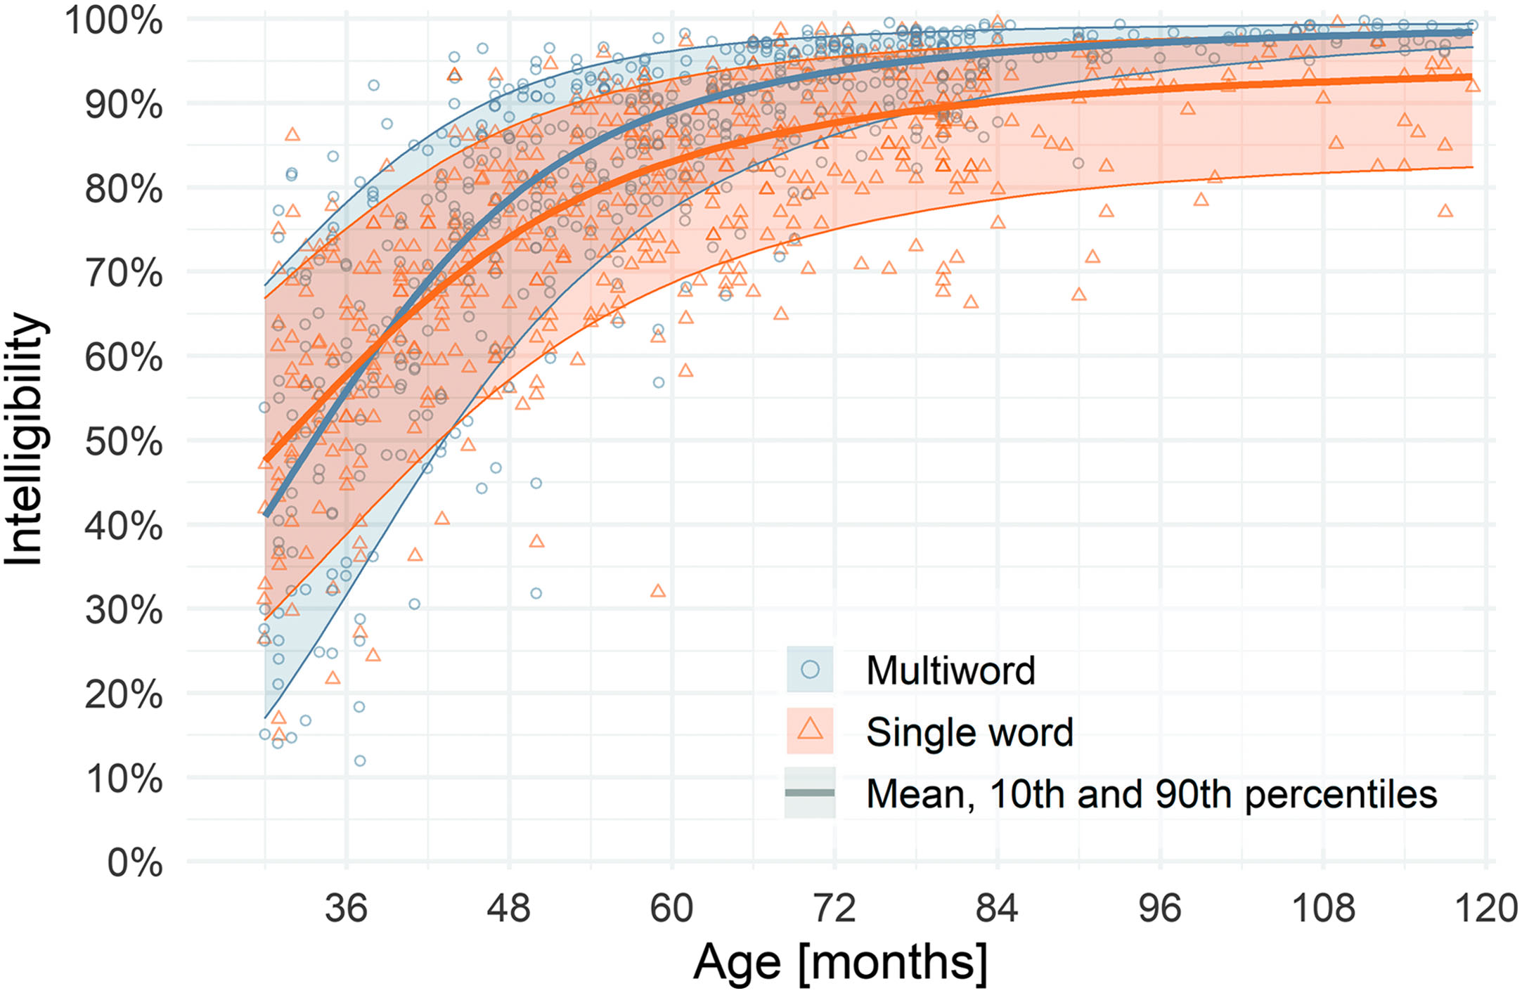
The Psychology of Language
Debate Example 4: How Do Children Learn Words So Fast?
New words learned in a single glance
Innate biases or learned associations?
Speed reveals the mind’s hidden structure
Notes:
Children acquire thousands of words in just a few years—often after hearing them once or twice.
This fast mapping ability seems almost magical: after a single exposure, toddlers can connect a novel word to its referent and remember it for days.
Some researchers argue that such speed points to innate constraints—built-in expectations about how words map onto the world.
These biases, like the “whole-object” or “taxonomic” assumptions, help narrow infinite possibilities to a manageable few.
But others find that children can achieve the same results through statistical inference.
In studies by Smith and Yu, learners tracked which words co-occurred with which objects across scenes.
Even without explicit cues, they inferred correct mappings simply by aggregating probabilistic evidence.
This suggests that apparent insight may emerge from domain-general learning mechanisms tuned to structure in the input.
Context and social cues make the process even faster.
Children use contrast (“not the blue one”), gaze direction, and communicative intent to refine guesses.
A single experience often carries multiple layers of evidence—perceptual, pragmatic, and linguistic—that jointly point to meaning.
Fast mapping, then, may be the visible result of many interacting skills operating beneath awareness.
Most researchers now see word learning as a hybrid system.
Innate expectations constrain the hypothesis space, while experience and social context fill it in.
What looks like instant insight may in fact be the culmination of a powerful, predictive learner—one that unites constraint, computation, and curiosity.

Slide 20

The Psychology of Language
Debate Example 5: Word-Order Universals and Typology
Are all languages built on shared rules?
Universal Grammar or cultural adaptation?
Patterns may reflect processing, not prescription
Notes:
Across the world’s 7,000 languages, word order varies enormously—yet not randomly.
Most languages place the subject before the object, and certain combinations recur far more often than others.
In the 1960s, linguist Joseph Greenberg cataloged these patterns, proposing that they reveal deep universals of human grammar.
Chomsky and others took such regularities as evidence that all languages draw from a common innate blueprint.
But later work suggested that these patterns might arise from cultural and cognitive pressures, not from fixed mental rules.
Languages evolve through generations of speakers, adapting to how humans process and learn.
Orders that make parsing easier or reduce ambiguity tend to persist; rare or inefficient ones fade.
From this view, universals emerge through iterated learning and processing optimization, not genetic programming.
Computational models support this adaptive account.
When artificial agents are trained to communicate efficiently, stable patterns of word order emerge spontaneously.
These simulated “languages” favor predictable, easy-to-learn structures that resemble those in real human languages.
Grammar, it seems, can evolve through usage and transmission alone.
The typology debate thus extends the symbolic vs. learning divide from individuals to cultures.
Universal Grammar sees linguistic patterns as reflections of the brain’s design; usage-based theories see them as products of human history and communication.
Either way, the striking regularities across languages remind us that language is not just invented—it is continually shaped by minds, memory, and interaction over time.

Slide 21
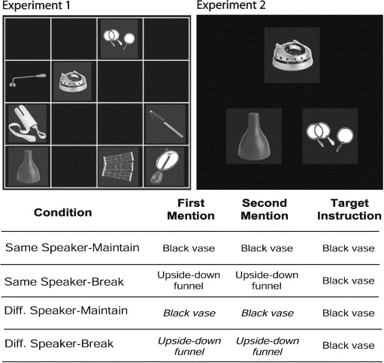
The Psychology of Language
Debate Example 6: Pragmatics and Theory of Mind
Language means more than it says
Do we need a special module for intention?
Understanding minds may underlie understanding words
Notes:
Even when grammar and vocabulary are clear, speakers often mean something beyond their literal words.
When someone says, “Can you pass the salt?”, we don’t answer “yes”—we hand them the salt.
Interpreting this correctly requires recognizing intent, not just processing syntax.
This ability to infer what another person means rather than what they say lies at the heart of pragmatics.
One view holds that pragmatic understanding depends on our general capacity for Theory of Mind—the ability to represent others’ beliefs, desires, and goals.
According to Relevance Theory (Sperber & Wilson), listeners constantly infer the speaker’s intended meaning by balancing effort and informativeness.
Children’s success on false-belief tasks predicts their pragmatic understanding, suggesting that both rely on shared cognitive mechanisms.
From this perspective, language comprehension is fundamentally an act of mindreading.
But pragmatics is not only about interpreting meaning—it’s also about producing it effectively.
The concept of audience design proposes that speakers actively tailor what they say for their listener’s needs.
We choose words, detail, and tone based on what we believe the listener already knows.
For example, we might say “the red mug” to a friend but “Jon’s favorite mug” to a new lab mate, adjusting for shared knowledge.
This adaptation requires both social reasoning and real-time inference about the listener’s perspective.
Whether audience design reflects a distinct linguistic ability or a general social strategy remains debated.
Some evidence suggests speakers automatically simplify or elaborate speech depending on context; others find this adjustment to be effortful and inconsistent.
Either way, it shows that language production, like comprehension, is guided by predictions about how minds connect.
Communication succeeds when both sides model each other accurately.
Most modern accounts now see pragmatics as the meeting point of language and social cognition.
It draws on the same mechanisms used for empathy and prediction but channels them through structured linguistic conventions.
Understanding and producing meaning require an ongoing negotiation between what is said, what is intended, and what is understood—
a dance of minds that turns speech into shared thought.

Slide 22
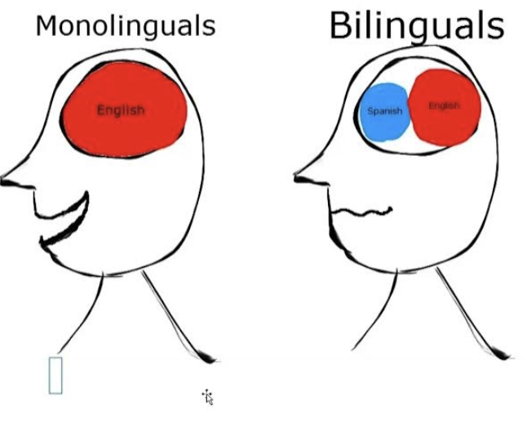
The Psychology of Language
Debate Example 7: Bilingualism and Cross-Linguistic Influence
Two languages, one mind
Does each follow fixed rules or share common ground?
Flexibility may reveal how language adapts
Notes:
Bilingualism provides a natural test of how flexible the language system really is.
If grammar is hardwired and universal, managing two languages should involve switching between two separate, stable systems.
If language is experience-based, the two systems should interact, shaping and reshaping each other through use.
Decades of research now show that bilinguals provide evidence for both.
Speakers often experience cross-linguistic influence—patterns from one language subtly affecting another.
Spanish–English speakers might say “explain me this” under influence from explicarme, or adapt word order to match the other language’s rhythm.
These blending effects show that grammatical representations are not sealed modules but dynamic networks tuned by exposure.
The same brain can accommodate overlapping structures without confusion.
At the same time, bilinguals maintain separate control systems that let them inhibit one language while using another.
Neuroimaging and behavioral data show enhanced executive control—greater ability to switch tasks and ignore interference.
This suggests that even if language structures interact, the mind still keeps track of which system to apply.
Flexibility and constraint coexist within a single cognitive architecture.
Bilingualism therefore bridges the rule-versus-learning divide.
Languages are distinct enough to require structured representation, yet plastic enough to adapt through experience.
This dual nature may capture the essence of language itself: not a fixed code or a pure habit, but an evolving equilibrium between structure and use—sculpted by every speaker who navigates more than one world of words.

Slide 23
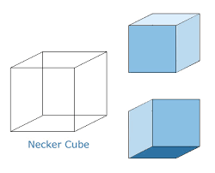
The Psychology of Language
Integrating Theories: Hybrid Models
Rules and learning each explain part of the story
Structure and experience work hand in hand
Language may be both built and built-upon
Rules
Statistics
Rules or Statistics?
Notes:
Across all these debates, a pattern emerges: neither the symbolic nor the learning view tells the whole story.
Rules capture the systematic structure of language, but not its flexibility.
Learning models explain adaptation and variation, but often miss the deeper constraints that make language coherent.
The evidence suggests that the mind combines both—structured representations shaped and refined by experience.
Hybrid models formalize this synthesis.
Dual-route theories propose separate systems for regular and irregular patterns—rules for the predictable, memory for exceptions.
Probabilistic grammars and Bayesian models treat syntax as a scaffold, with learned frequencies guiding how rules are applied.
And connectionist frameworks have evolved to include symbolic-like layers that handle hierarchy and compositionality.
Across these lines, cognitive science is converging on a middle ground: structure that learns.
Developmental and neural evidence reinforce this integration.
Children start by imitating and memorizing but gradually extract abstract rules.
Brain imaging shows overlapping regions for rule processing and associative learning, suggesting continuous interaction rather than separate modules.
Language, in this sense, may be the archetype of a multi-level cognitive system—one that learns its own rules through use.
So the central question has shifted.
It is no longer “rules or learning?” but “how do rules emerge from learning, and how does learning depend on rules?”
Understanding that relationship connects the study of language to broader principles of cognition—how structured thought arises from experience.
That insight will guide our final lecture on this topic, where we turn to the brain systems that implement these intertwined processes.

Slide 24
The Psychology of Language
Other Major Questions in the Psychology of Language
Language connects to every corner of cognition
How it works reveals how the mind works
The questions keep expanding, not ending
Debate | Core Question
Language and Thought | Does the language we speak shape how we perceive and reason, or does thought exist independently of language?
Modularity vs. Integration | Is language a specialized cognitive module or a distributed system that shares resources with memory, attention, and perception?
Embodiment of Meaning | Are words and concepts grounded in sensorimotor experience, or represented abstractly and amodally in the mind?
Innateness vs. Cultural Evolution | Which aspects of linguistic structure reflect biological design, and which emerge through cultural transmission and learning?
Inner Speech and Cognitive Control | Does language function as a tool for self-regulation and planning, or is inner speech just a by-product of thought?
Notes:
Even after seventy years of research, the core mysteries of language remain open.
We now understand much about how grammar and learning interact,
but less about how language interfaces with thought.
Does speaking a particular language shape how we perceive, reason, and remember the world?
Or do all humans share a common conceptual framework that language merely labels?
This enduring language-and-thought debate
—from Sapir and Whorf to modern cross-linguistic research
—remains central to cognitive science.
Current research also examines language in broader context.
How do listeners use memory and prediction to interpret conversation in real time?
How do bilinguals or signers mentally organize multiple linguistic systems?
And how do languages evolve and diversify while still reflecting shared human constraints?
New tools continue to expand these frontiers.
Neuroimaging and computational modeling reveal
that linguistic processes draw on distributed networks, not isolated centers.
Large-scale cross-cultural studies are testing how linguistic diversity maps onto cognitive diversity.
And models of large language systems invite new comparisons between human learning and artificial prediction.
What unites all these efforts is a single goal: to understand how language makes thought visible.
It is both a cognitive system and a social instrument, bridging private minds and shared meaning.
In our next lecture, we turn from theory to implementation
—to how neural circuits and networks make this extraordinary system possible.

Slide 25
The Psychology of Language
Summary
From structure to learning to meaning
Language as prediction, communication, and thought
Next Time
How language actually works in the mind
Notes:
Today we explored how the human mind does language
—moving from historical theories to the evidence that tests them.
We began with Skinner’s learning-by-reinforcement view and Chomsky’s critique
that introduced the idea of innate mental grammar.
We then saw how connectionism, statistical learning,
and social-cognitive accounts reframed language as an emergent system
—one that learns structure from use, guided by interaction and intention.
Across the empirical debates, a consistent theme emerged: rules and learning are not rivals, but partners.
Children, bilinguals, and even neural networks reveal that linguistic knowledge is both structured and adaptive
—built through prediction, experience, and shared communication.
Language depends on brains that learn, but it also reshapes those brains through culture and use.
It is a cognitive system that grows from the interaction between pattern, purpose, and people.
Looking ahead, we’ll turn from theory to implementation
—asking how these processes are realized in the brain.
We’ll explore how neural circuits connect sound to meaning,
how language regions specialize and interact, and how plasticity allows recovery and change.
In tracing language from mind to brain, we’ll see how one of humanity’s most complex abilities
is woven into the biology that makes thought possible.

